Slide 1
Basic Selectors
Element, Class and ID Selector | Descendant Selector | Pseudo-Class Selector
Notes:
Welcome to out lecture on basic css selectors. In this lecture we will go through element, class and id selectors, descendant selector, and pseudo class selector. Let’s start our lecture.

Slide 2
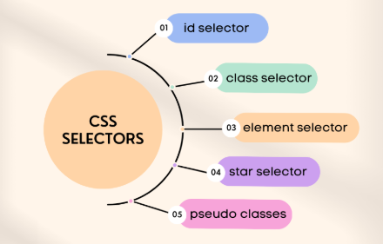
Element, Class and ID Selector
Element Selector: Targets elements by name, e.g., p { color: blue; }.
Class Selector: Targets elements with a class, e.g., .notice { color: blue; }.
ID Selector: Targets an element with a specific ID, e.g., #byLine { color: blue; }.
Usage: Element for broad styling, class for groups, and ID for unique elements.
Notes:
CSS offers three common selectors for styling. The element selector targets elements by their name, such as p for paragraphs. The class selector targets elements with a specific class, using a period before the class name, e.g., notice. The ID selector targets a unique element with a specific ID using a hash, e.g., by Line. Use elements for general styles, classes for groups, and IDs for unique styling.

Slide 3
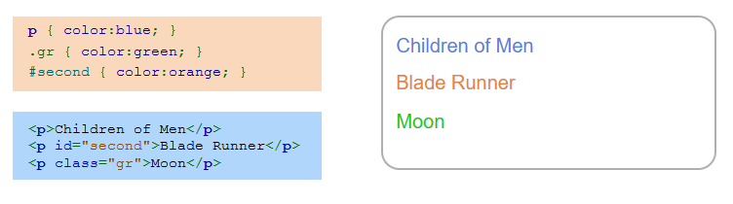
Example
Notes:
This example demonstrates element, class, and ID selectors in CSS. The element selector p applies blue to all paragraphs. The ID selector second specifically targets the paragraph with id equal to second, making it orange. The class selector .gr applies green to the paragraph with class equal to gr. This shows how different selectors target specific elements for styling flexibility.

Slide 4
Descendant Selector
Descendant Selector: Matches elements inside other elements.
Syntax: Use a space between selectors, e.g., h2 em.
Example: h2 em { color: blue; } styles em inside h2.
Notes:
Next comes descendant selector. The descendant selector matches elements nested inside other elements. It is written by separating selectors with a space. For example, h2 EM with blue color applies the style only to EM elements that are inside H2 elements. This allows targeted styling of elements based on their relationship in the document structure, enhancing precision in CSS design.

Slide 5
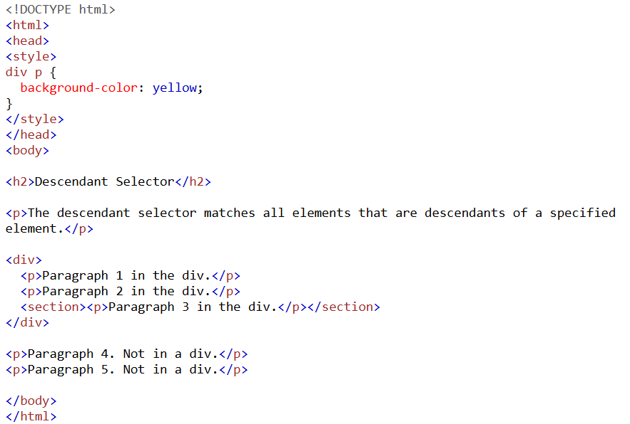
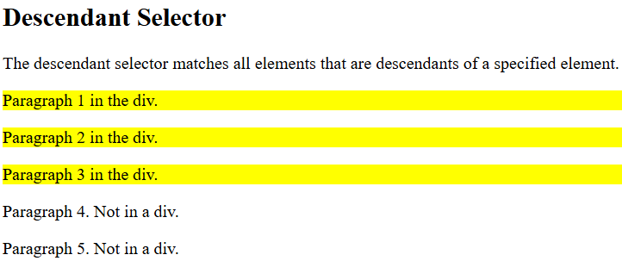
Descendant Selector Example
Notes:
This example demonstrates the descendant selector in CSS. The rule DIV p background with yellow color applies the yellow background to all p elements that are inside a DIV element. Paragraphs outside the DIV are not affected. The descendant selector targets nested elements, enabling precise styling based on their relationship within the HTML structure.

Slide 6
Pseudo-class selector
Pseudo-Class Selector: Uses : to match elements by user behavior or meta info. Some pseudo-class selectors include:
:disabled - Element is disabled.
:hover - Mouse is hovering over the element.
:empty - Element has no child elements.
:lang(language) - Element contains text in a specified language.
:nth-child(n) - Element is the parent element's nth child.
Notes:
Finally we will include the pseudo class selectors. A pseudo class selector uses a colon to apply styles based on user behavior or element metadata. Examples include colon disabled for disabled elements, colon hover for elements under the mouse, colon empty for elements without child elements, colon lang for text in a specific language, and colon nth child n for targeting the nth child of a parent. These selectors enable dynamic and conditional styling in CSS.

Slide 7
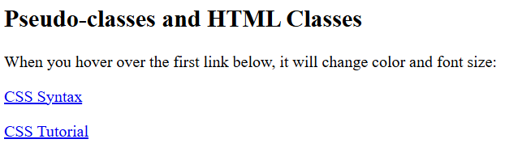
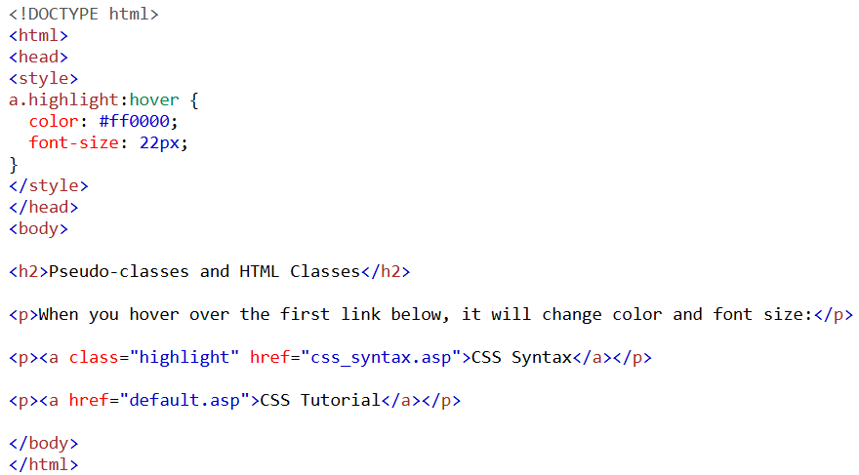
Example
Notes:
This example demonstrates the use of pseudo-classes and HTML classes. The CSS rule a dot highlight colon hover changes the text color to red and font size to 22px when hovering over a link with the class highlight. The first link CSS Syntax is styled with this hover effect, while the second link CSS Tutorial uses default styles. Pseudo classes like hover add dynamic interactions to elements. Thanks for watching the lecture.

